Slide 1
CISCO PROJECT 9
Session Initiation Protocol
Akash Ranjan Das 1SI18CS008
Rakshita Bantwal 1SI18CS085
Hrithik Rajput 1SI18CS042

Slide 2
Session Initiation Protocol (SIP)
What is VoIP Technology ?
Where Does SIP Fit ?
Network Elements
WireShark Capture
Python Analysis
Visualization using Matplotlib
Visualizing Three PCAP files
AGENDA

Slide 3
Session Initiation Protocol (SIP)
Session Initiation Protocol (SIP) is one of the most common protocols used in VoIP technology.

Slide 4
Voice over Internet Protocol
Voice & Multimedia
What is VoIP Technology ?
Video Conferencing
Cheap & Portable

Slide 5
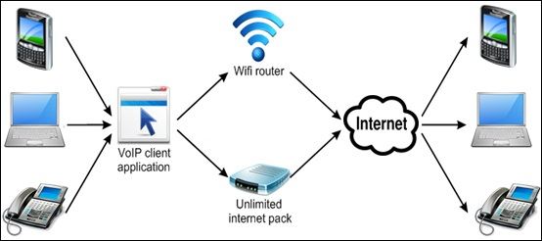

Slide 6
Session Initiation Protocol (SIP)
Session Initiation Protocol (SIP) is one of the most common protocols used in VoIP technology.
It is an application layer protocol that works in conjunction with other application layer protocols to control multimedia communication sessions over the Internet.
SIP is a signalling protocol used to create, modify, and terminate a multimedia session over the Internet Protocol.
A session is nothing but a simple call between two endpoints.
An endpoint can be a smartphone, a laptop, or any device that can receive and send multimedia content over the Internet.

Slide 7
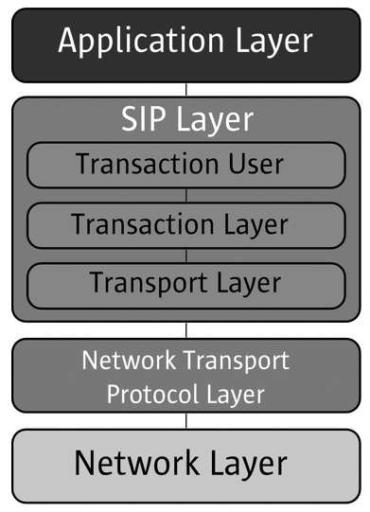
Where Does SIP Fit?
Basically SIP is an application layer protocol. It is a simple network signalling protocol for creating and terminating sessions with one or more participants.
The SIP protocol is designed to be independent of the underlying transport protocol, so SIP applications can run on TCP, UDP, or other lower-layer networking protocols.

Slide 8
Network Elements
USER AGENT
PROXY SERVER
REGISTRAR SERVER
REDIRECT SERVER
LOCATION SERVER

Slide 9

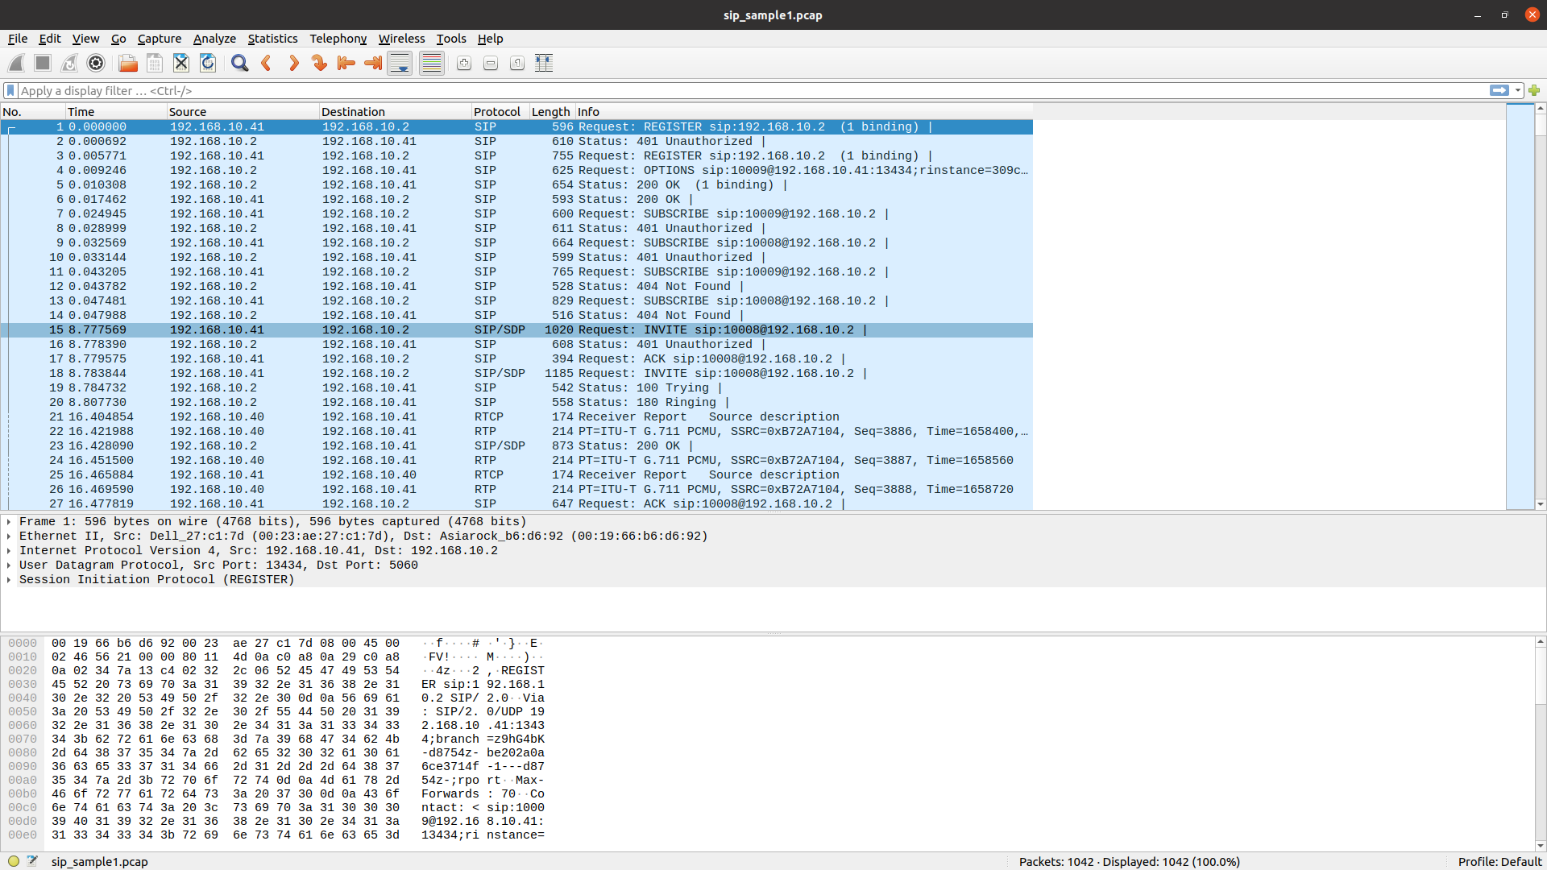
WireShark Capture

Slide 10
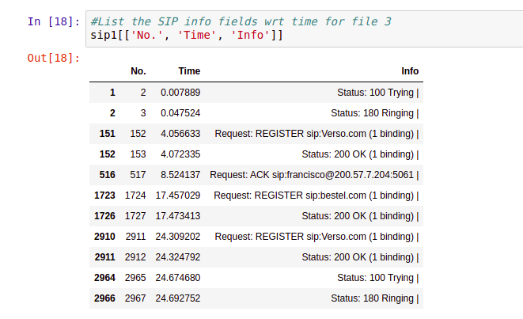
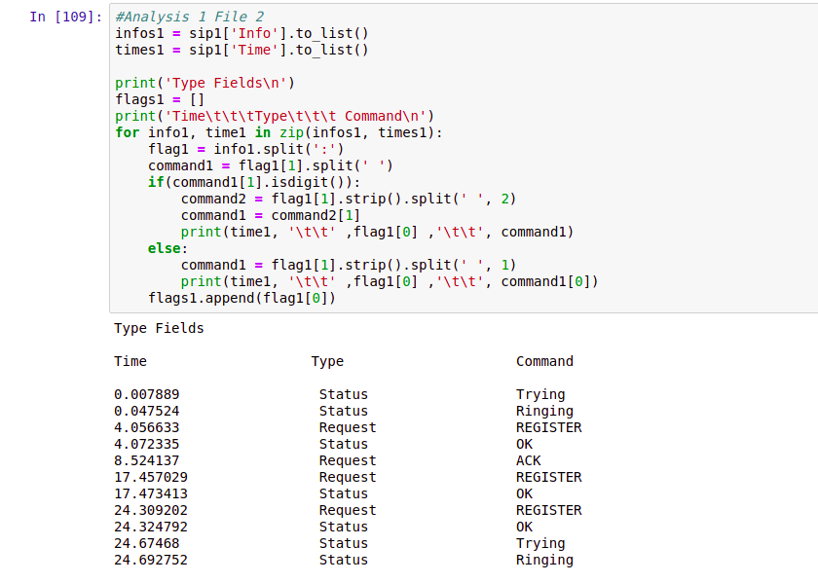
Python Analysis

Slide 11
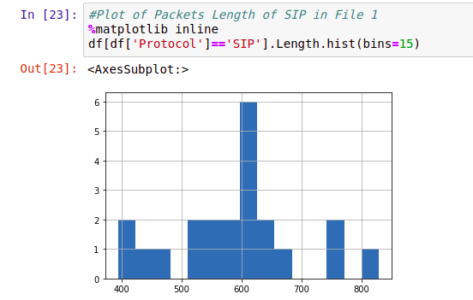
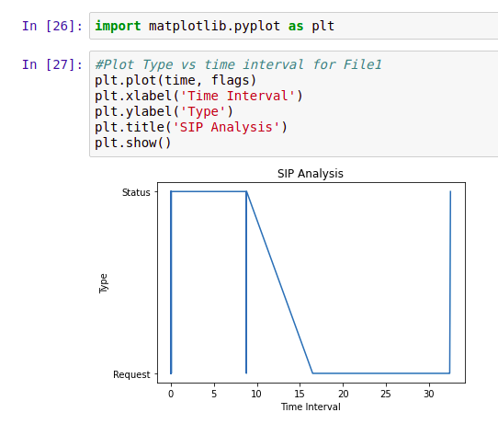
Visualization using Matplotlib
Packets Length vs time
Type vs Time interval

Slide 12
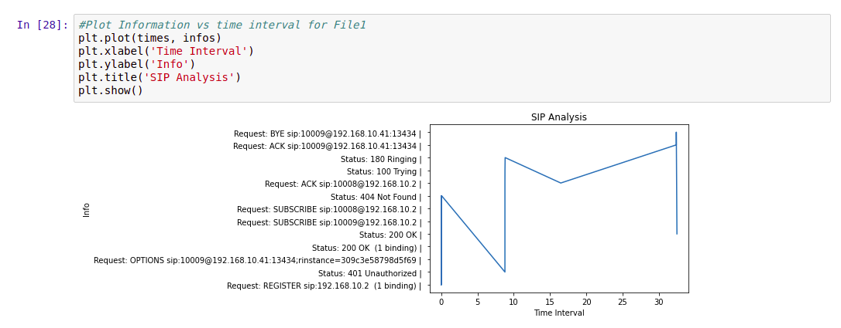
Visualization using Matplotlib
Info vs Time Interval

Slide 13
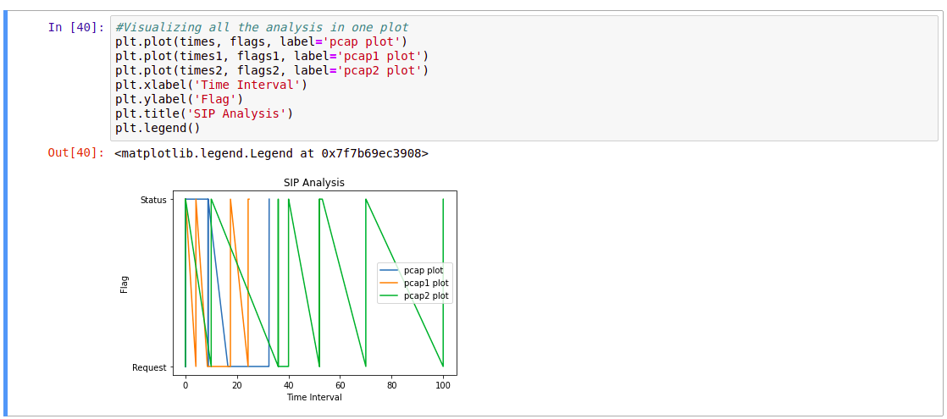
Visualizing Three PCAP files

Slide 14

THANK YOU

